Slide 1

Name | Vijayalaxmi Kaleguddi
Enrolment No | EBEON0322577479
Batch | 2021-7233
Center | Bangalore EXL

Slide 2
Predicting Home Prices in Bangalore
Guided by:
Kartik V.
By
Vijayalaxmi Kaleguddi

Slide 3
content
Data Cleaning
Data Visualization
Removing Outlier
Dimensionality Reduction
Prepare for model building
Model building
Find the among the three Algorithm which one is best.

Slide 4
Objective
Predicting the home prices in Bangalore using Linear Regression, Lasso Regression and Decision Tree Regression and finding which one gives best score to find prices of home.

Slide 5
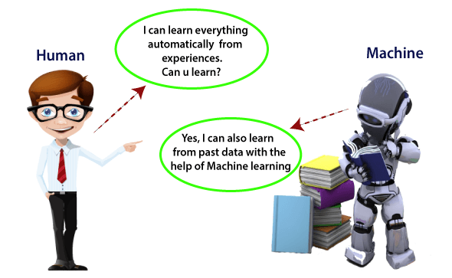
Introduction
What is Machine Learning
In the real world, we are surrounded by humans who can learn everything from their experiences with their learning capability, and we have computers or machines which work on our instructions. But can a machine also learn from experiences or past data like a human does? So here comes the role of Machine Learning.

Slide 6
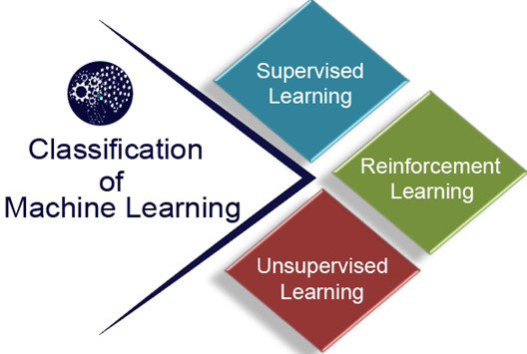
Classification of Machine Learning
At a broad level, machine learning can be classified into three types:
Supervised learning
Unsupervised learning
Reinforcement learning

Slide 7
Supervised Learning
Supervised learning is a type of machine learning method in which we provide sample labeled data to the machine learning system in order to train it, and on that basis, it predicts the output.
The goal of supervised learning is to map input data with the output data. The supervised learning is based on supervision, and it is the same as when a student learns things in the supervision of the teacher. The example of supervised learning is spam filtering.
Supervised learning can be grouped further in two categories of algorithms:
Classification
Regression

Slide 8
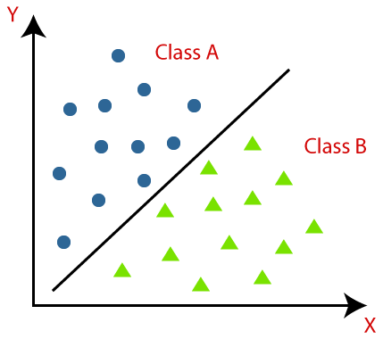
Classification
The Classification algorithm is a Supervised Learning technique that is used to identify the category of new observations on the basis of training data. In Classification, a program learns from the given dataset or observations and then classifies new observation into a number of classes or groups. Such as, Yes or No, 0 or 1, Spam or Not Spam, cat or dog, etc. Classes can be called as targets/labels or categories.
y=f(x), where y = categorical output
Binary Classifier: If the classification problem has only two possible outcomes, then it is called as Binary Classifier. Examples: YES or NO, MALE or FEMALE, SPAM or NOT SPAM, CAT or DOG, etc.
Multi-class Classifier: If a classification problem has more than two outcomes, then it is called as Multi-class Classifier. Example: Classifications of types of crops, Classification of types of music.

Slide 9
Regression
Regression analysis is a statistical method to model the relationship between a dependent (target) and independent (predictor) variables with one or more independent variables.
It predicts continuous/real values such as temperature, age, salary, price, etc.
"Regression shows a line or curve that passes through all the datapoints on target-predictor graph in such a way that the vertical distance between the datapoints and the regression line is minimum."

Slide 10
Why do we use Regression Analysis?
As mentioned above, Regression analysis helps in the prediction of a continuous variable. In that some point are:
Regression estimates the relationship between the target and the independent variable.
It is used to find the trends in data.
It helps to predict real/continuous values.
By performing the regression, we can confidently determine the most important factor, the least important factor, and how each factor is affecting the other factors.

Slide 11
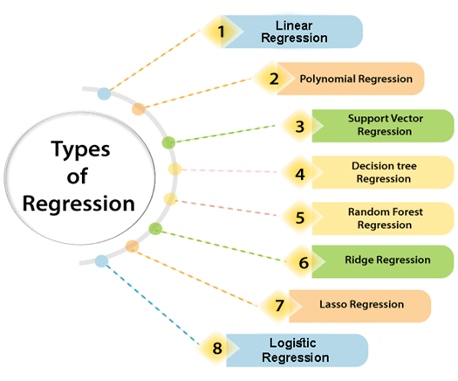

Slide 12
Linear Regression:
Linear regression is a statistical regression method which is used for predictive analysis.
It is one of the very simple and easy algorithms which works on regression and shows the relationship between the continuous variables.
It is used for solving the regression problem in machine learning.
Linear regression shows the linear relationship between the independent variable (X-axis) and the dependent variable (Y-axis), hence called linear regression.
If there is only one input variable (x), then such linear regression is called simple linear regression. And if there is more than one input variable, then such linear regression is called multiple linear regression.
The relationship between variables in the linear regression model can be explained using the below image. Here we are predicting the salary of an employee on the basis of the year of experience.

Slide 13
Equation of linear regression:
Y= aX+b
Here, Y = dependent variables (target variables), X= Independent variables (predictor variables), a and b are the linear coefficients
Some popular applications of linear regression are:
Analyzing trends and sales estimates
Salary forecasting
Real estate prediction
Arriving at ETAs in traffic.
Predicting Home price in Bangalore city

Slide 14
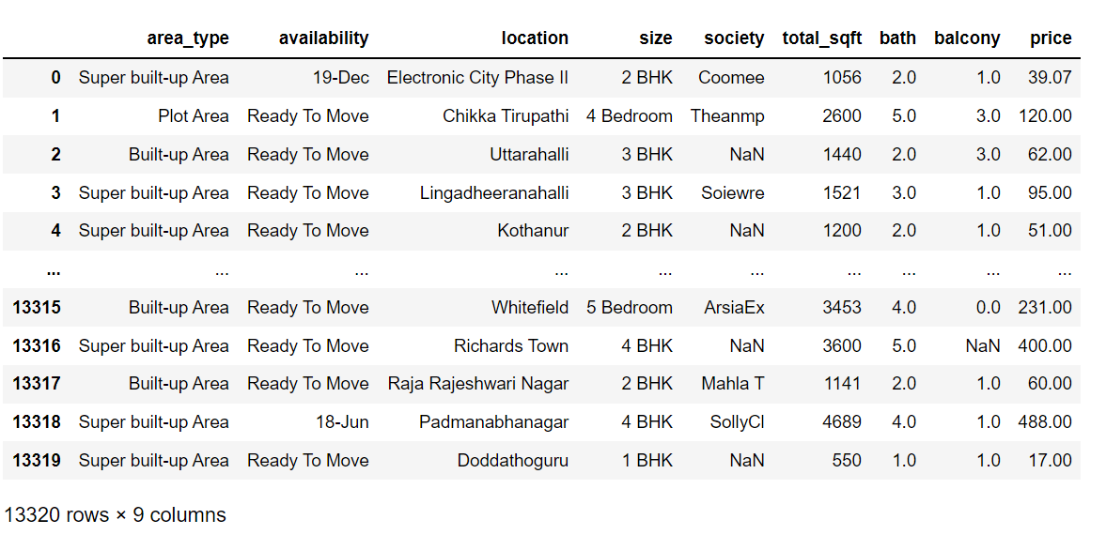

Slide 15
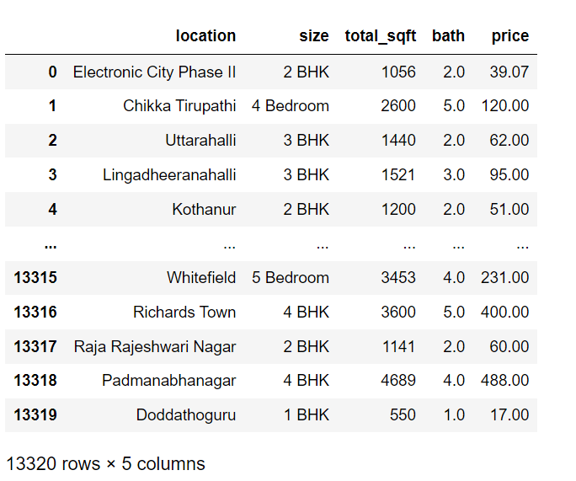
Drop features that are not required to build our model
Dropping the columns area type, society, balcony, availability

Slide 16
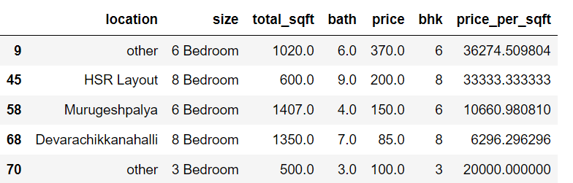
Outlier Removal Using Business Logic
As a data scientist when you have a conversation with your business manager (who has expertise in real estate), he will tell you that normally square ft per bedroom is 300 (i.e. 2 bhk apartment is minimum 600 sqft. If you have for example 400 sqft apartment with 2 bhk than that seems suspicious and can be removed as an outlier. We will remove such outliers by keeping our minimum thresold per bhk to be 300 sqft

Slide 17
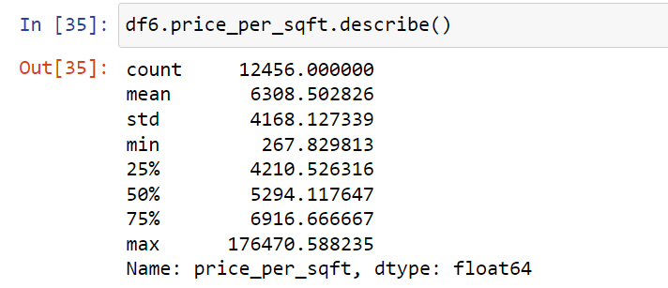
Outlier Removal Using Standard Deviation and Mean
Here we find that min price per sqft is 267 rs/sqft whereas max is 12000000, this shows a wide variation in property prices. We should remove outliers per location using mean and one standard deviation

Slide 18
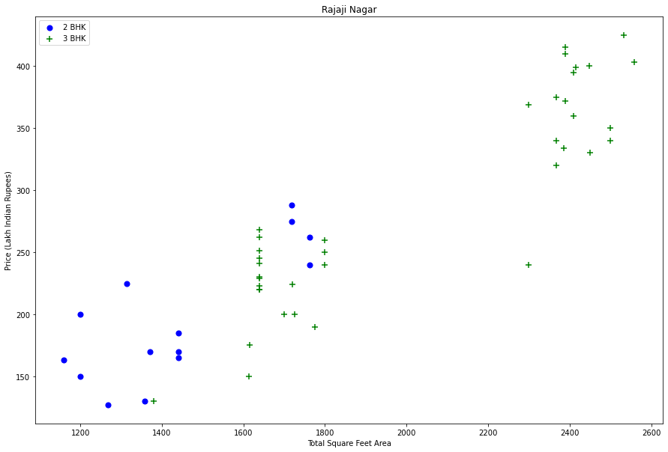
Let's check if for a given location how does the 2 BHK and 3 BHK property prices look like

Slide 19
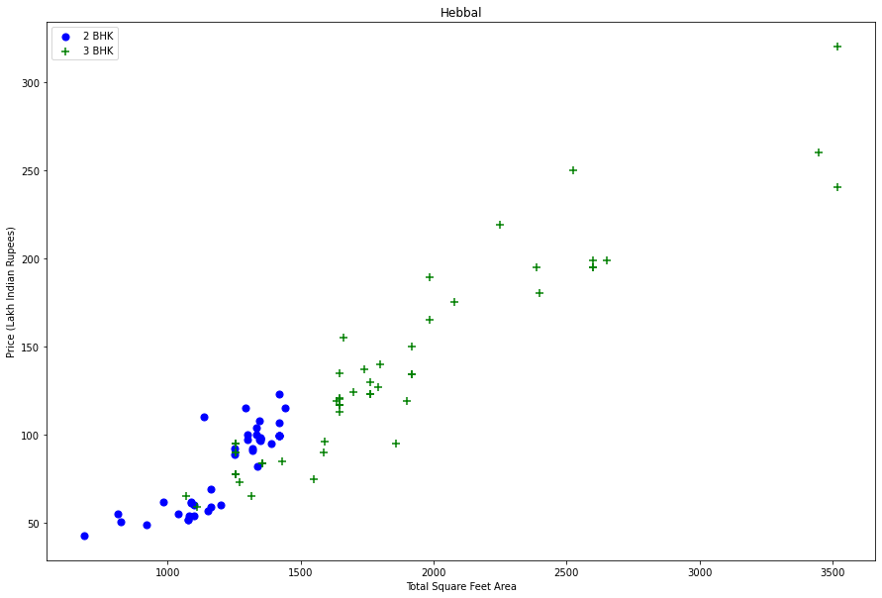

Slide 20
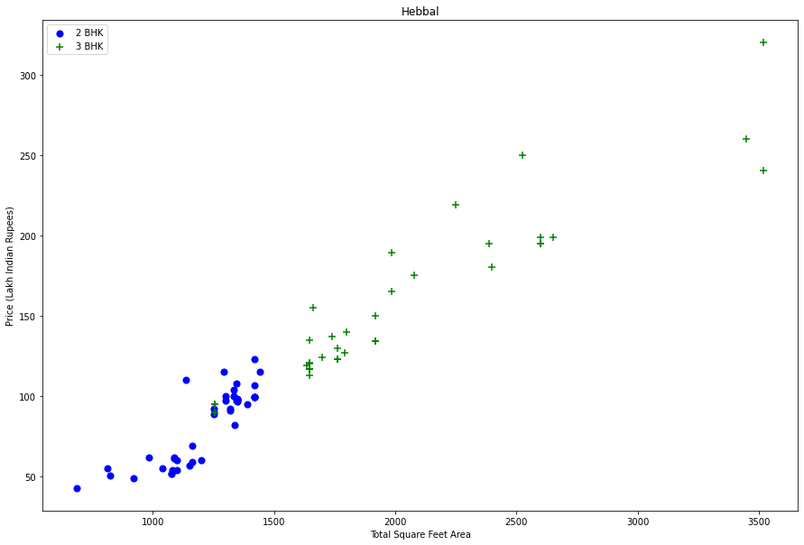
After removing Outlier

Slide 21
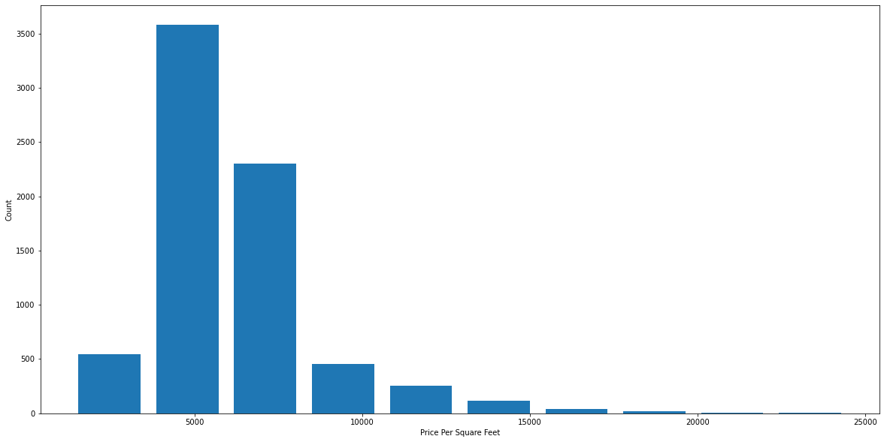
Histogram of Price Per Square fit

Slide 22
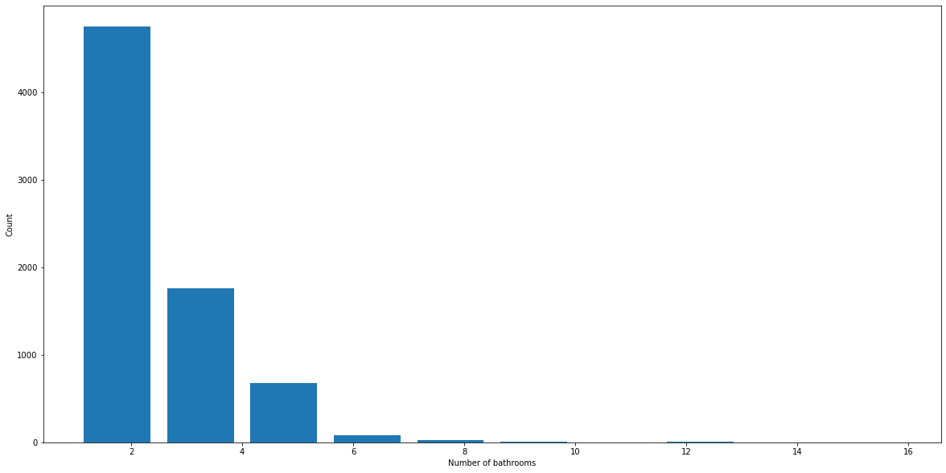
Outlier Removal Using Bathrooms Feature

Slide 23
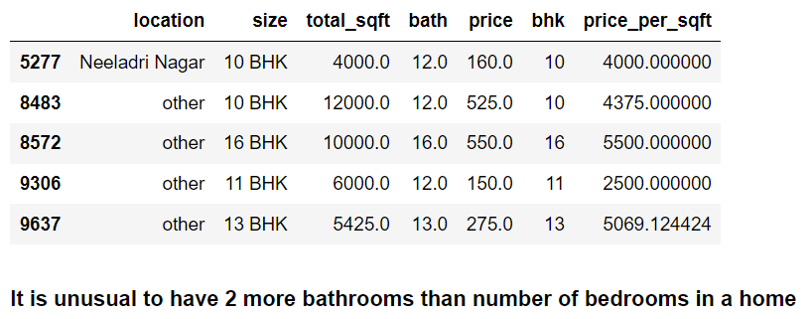
Again the business manager has a conversation with us (i.e. a data scientist) that if you have 4 bedroom home and even if you have bathroom in all 4 rooms plus one guest bathroom, you will have total bath = total bed + 1 max. Anything above that is an outlier or a data error and can be removed

Slide 24
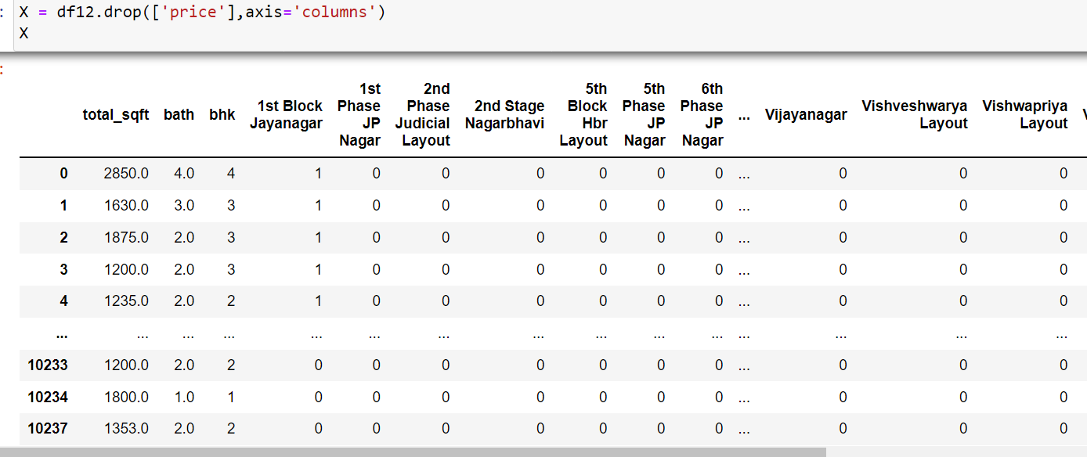

Build a Model Now...

Slide 25
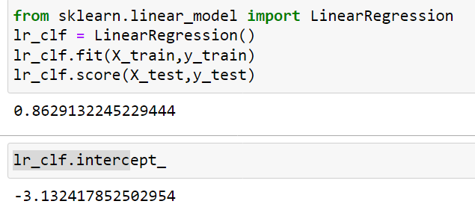
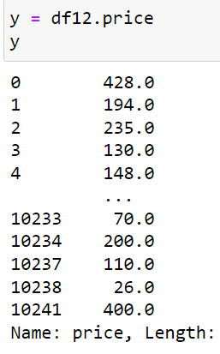
Use K Fold cross validation to measure accuracy of our Linear Regression model
0.82702546, 0.86027005, 0.85322178, 0.8436466 , 0.85481502
We can see that in 5 iterations we get a score above 80% all the time. This is pretty good but we want to test few other algorithms for regression to see if we can get even better score. We will use GridSearchCV for this purpose

Slide 26
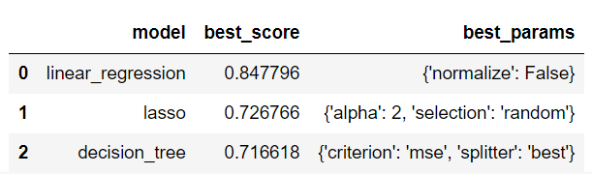
Find best model using GridSearchCV
GridSearchCV is a module of the Sklearn model_selection package that is used for Hyperparameter tuning. Given a set of different hyperparameters, GridSearchCV loops through all possible values and combinations of the hyperparameter and fits the model on the training dataset. In this process, it is able to identify the best values and combination of hyperparameters (from the given set) that produces the best accuracy.

Slide 27




Conclusion
Based on above results we can say that Linear Regression gives the best score. Hence we will use that.
Linear Regression gives us above 80% accuracy

Slide 28


Slide 29


